Slide 1
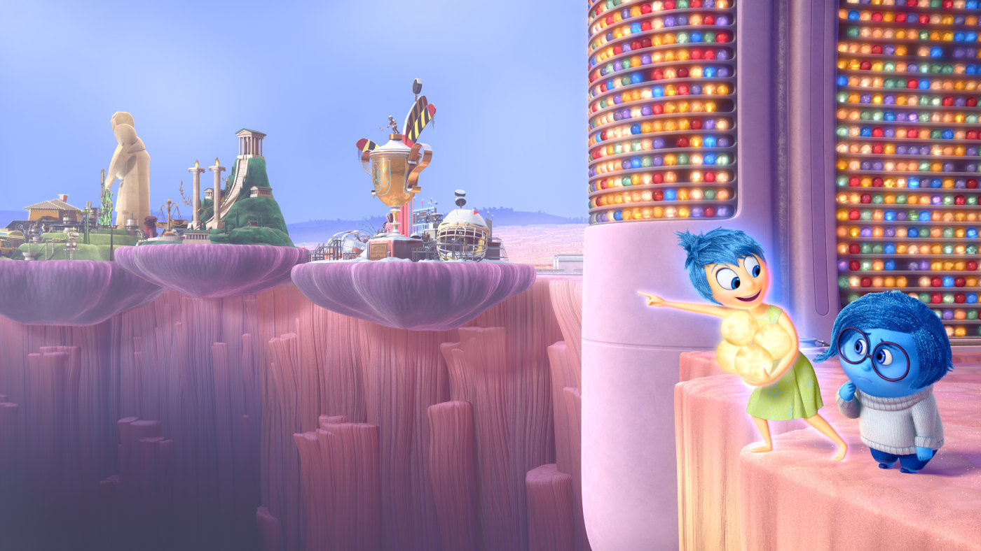
Introduction
CS423: Computer Graphics
Still from Pixar’s Inside Out, 2015
Notes:
Short clip on multitouch

Slide 2
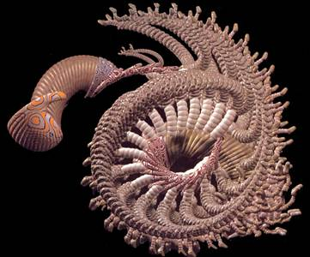
What is Computer Graphics? (1/2)
Computer graphics generally means creation, storage and manipulation of models and images
Such models come from diverse and expanding set of fields including physical, biological, mathematical, artistic, and conceptual/abstract structures
Frame from animation by William Latham, shown at SIGGRAPH 1992. Latham creates his artwork using rules that govern patterns of natural forms.

Slide 3
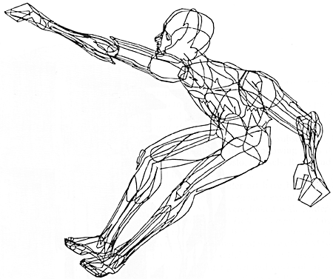
What is Computer Graphics? (2/2)
William Fetter coined term “computer graphics” in 1960 to describe new design methods he was pursuing at Boeing for cockpit ergonomics
Created a series of widely reproduced images on “pen plotter” exploring cockpit design, using 3D model of human body.
“Perhaps the best way to define computer graphics is to find out what it is not. It is not a machine. It is not a computer, nor a group of computer programs. It is not the know-how of a graphic designer, a programmer, a writer, a motion picture specialist, or a reproduction specialist.
Computer graphics is all these – a consciously managed and documented technology directed toward communicating information accurately and descriptively.”
Computer Graphics, by William A. Fetter, 1966

Slide 4
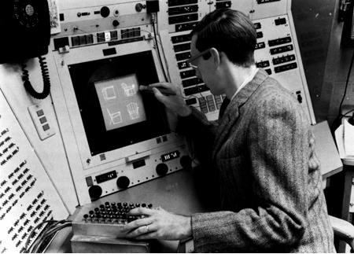
What is Interactive Computer Graphics?
User controls content, structure, and appearance of objects and their displayed images via rapid visual feedback
Basic components of an interactive graphics system
input (e.g., mouse, stylus, multi-touch, in-air fingers…)
processing (and storage of the underlying representation/model)
display/output (e.g., screen, paper-based printer, video recorder…)
First truly interactive graphics system, Sketchpad, pioneered by Ivan Sutherland 1963 Ph.D. thesis Sketchpad, A Man-Machine Graphical Communication System
Used TX-2 transistorized “mainframe” at MIT Lincoln Lab
Note CRT monitor, light pen, and function-key panels – the “organ console” showing bi-manual operation

Slide 5
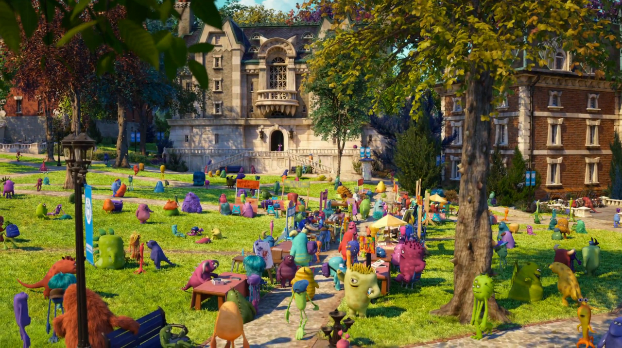
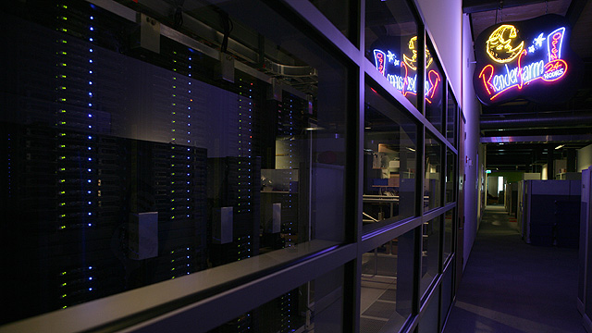
What is Batch Computer Graphics?
Today, still use non-interactive batch mode for final production-quality video and film (special effects – FX). Rendering a single frame of Monsters University (a 24 fps movie) averaged 29 hours on a 24,000-core render farm!
Still from Monsters University
Render farm
Notes:
http://venturebeat.com/2013/04/24/the-making-of-pixars-latest-technological-marvel-monsters-university/

Slide 6
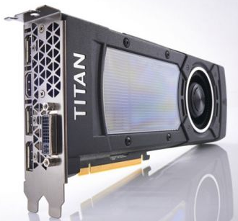
Enabling Modern Computer Graphics (1/5)
Hardware revolution
Moore’s Law: every 12-18 months, computer power improves by factor of 2 in price / performance as size shrinks
Newest CPUs are 64-bit with 2, 4, 6, 8, even up to 18 cores
Intel Skylake – consumer processor with 4 cores, 8 threads, and a fully featured graphics chip built in to the processor
Significant advances in commodity graphics chips every 6 months vs. several years for general purpose CPUs
NVIDIA GeForce GTX Titan X… 3072 cores, 12GB memory, and 7 teraflops of processing power in a single chip
Notes:
http://en.wikipedia.org/wiki/Comparison_of_Nvidia_graphics_processing_units#GeForce_700_Series

Slide 7
Enabling Modern Computer Graphics (2/5)
Graphic subsystems
Offloads graphics processing from CPU to chip designed for doing graphics operations quickly
nVidia GeForce™, AMD Radeon™, and Intel HD and Iris Pro Graphics
GPUs originally designed to handle special-purpose graphics computations
Increasingly, GPUs used to parallelize other types of computation (known as GPGPU, or General-Purpose Computing on the Graphics Processing Unit)
Hardware show and tell: Dept’s NVIDIA GeForce GTX 460s
1.35 GHz clock, 1GB memory, 37.8 billion pixels/second fill rate
Old cards: GeForce 7300 GT: 350 MHz clock, 256 MB memory, 2.8 billion fill rate
Notes:
http://en.wikipedia.org/wiki/Comparison_of_Nvidia_graphics_processing_units#GeForce_400_Series

Slide 8
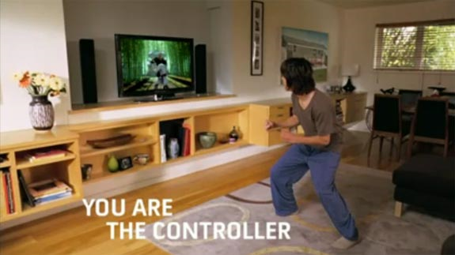
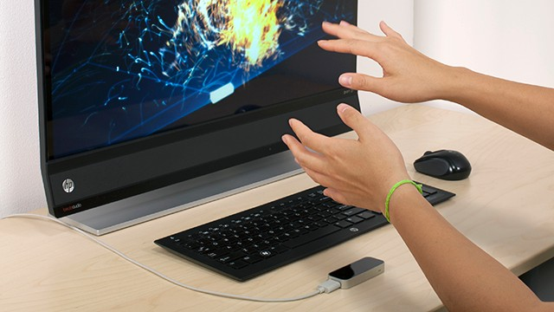
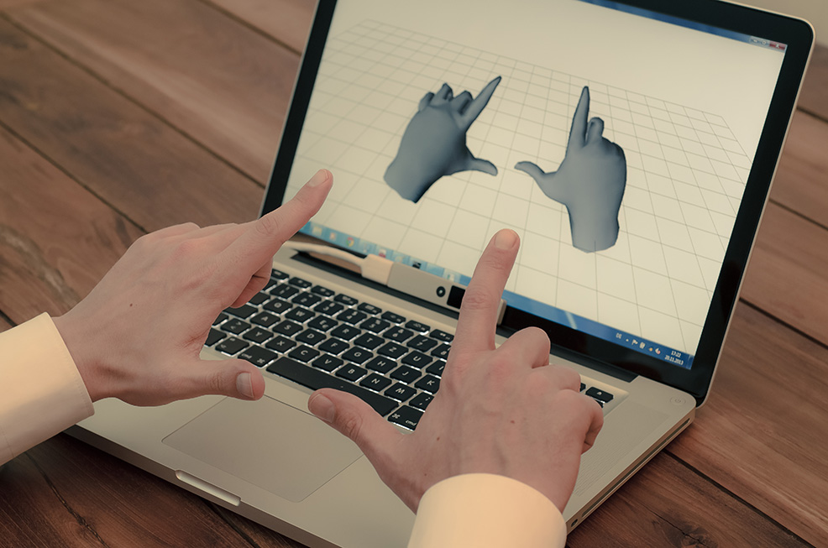
Enabling Modern Computer Graphics (3/5)
Input Devices
Mouse, tablet & stylus, multi-touch, force feedback, and other game controllers (e.g., Wii), scanner, digital camera (images, computer vision), etc.
Body as interaction device
Xbox Kinect
Leap Motion
Nimble UX

Slide 9
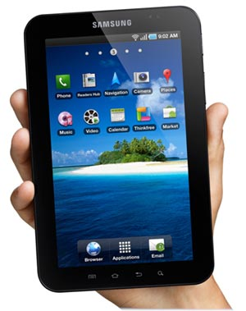
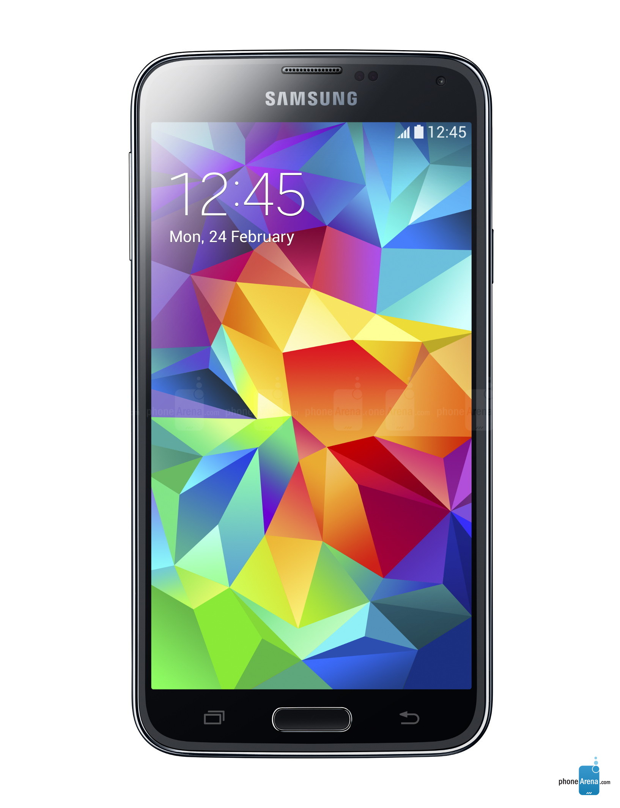
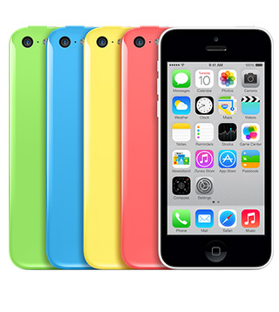
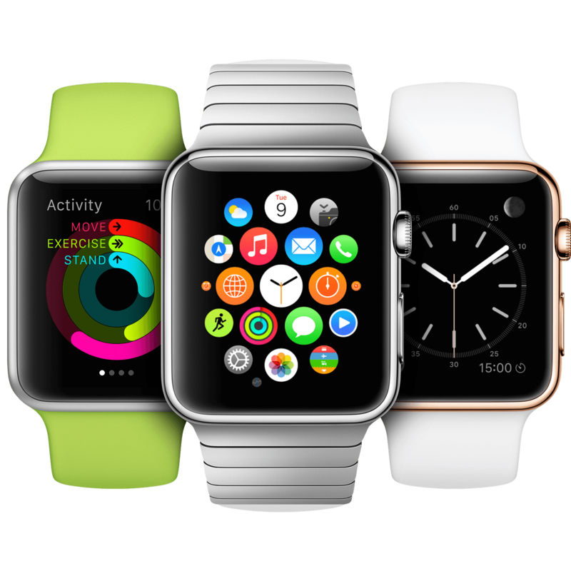
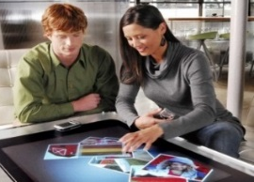
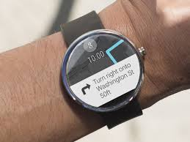
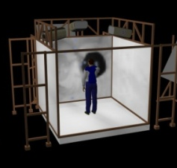
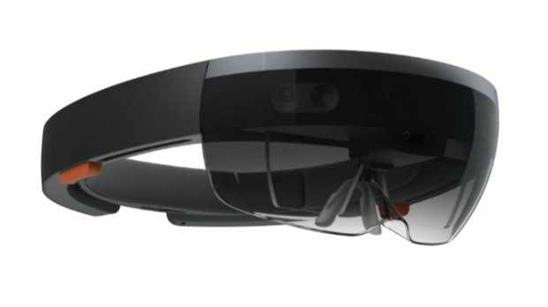
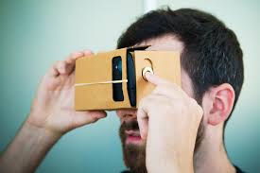
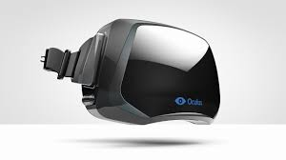
Enabling Modern Computer Graphics (4/5)
Many form factors
Smartphones/laptops/desktops/tablets
Smart watches
Head-mounted displays (HMDs)
Oculus bird simulator video
3D immersive virtual reality spaces
Android Phones
Apple iPhone
Tablets
Microsoft’s first Surface
Apple Watch
Android Wear
Microsoft Hololens
Oculus Rift
Google Cardboard
Brown’s old Cave

Slide 10
Enabling Modern Computer Graphics (5/5)
Software Improvements
Algorithms and data structures
Modeling of materials
Rendering of natural phenomena
“Acceleration data structures” for ray tracing and other renderers
Parallelization
Most operations are embarrassingly parallel: changing value of one pixel is often independent of other pixels
Distributed and Cloud computing
Send operations into ‘cloud’, get back results, don’t care how
Rendering even available as internet service!

Slide 11
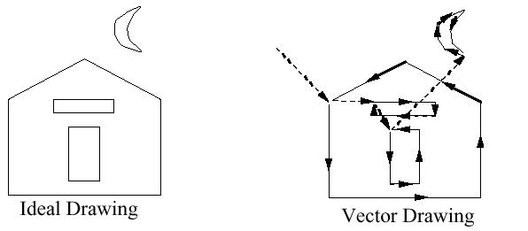

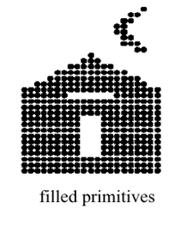
Graphics Display Hardware
Vector (calligraphic, stroke, random-scan)
Raster (TV, bitmap, pixmap) used in displays and laser printers
Driven by display commands
(move (x, y), char(“A”) , line(x, y)…)
Survives as “scalable vector graphics”
Driven by array of pixels (no semantics, lowest form of representation)
Note “jaggies” (aliasing errors) due to discrete sampling of continuous primitives
Ideal Drawing
Vector Drawing
Outline
Filled

Slide 12
Output Technology (1/3)
Calligraphic Displays
also called vector, stroke or line drawing graphics
lines drawn directly on phosphor
display processor directs electron beam according to list of lines defined in a "display list“
phosphors glow for only a few micro-seconds so lines must be redrawn or refreshed constantly
deflection speed limits # of lines that can be drawn without flicker.

Slide 13
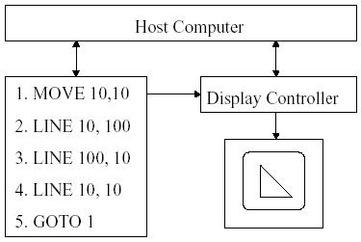
Vector Display Architecture

Slide 14
Output Technology (2/3)
Raster Display
Display primitives (lines, shaded regions, characters) stored as pixels in refresh buffer (or frame buffer)
Electron beam scans a regular pattern of horizontal raster lines connected by horizontal retraces and vertical retrace
Video controller coordinates the repeated scanning
Pixels are individual dots on a raster line

Slide 15
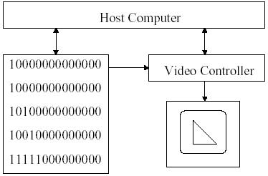
Raster displays Architecture

Slide 16
Output Technology (cont)
Bitmap is the collection of pixels
Frame buffer stores the bitmap
Raster display store the display primitives (line, characters, and solid shaded or patterned area)
Frame buffers
are composed of VRAM (video RAM).
VRAM is dual-ported memory capable of
Random access
Simultaneous high-speed serial output: built-in serial shift register can output entire scanline at high rate synchronized to pixel clock.

Slide 17
Pros and Cons
Advantages to Raster Displays
lower cost
filled regions/shaded images
Disadvantages to Raster Displays
a discrete representation, continuous primitives must be scan-converted (i.e. fill in the appropriate scan lines)
Aliasing or "jaggies" Arises due to sampling error when converting from a continuous to a discrete representation

Slide 18
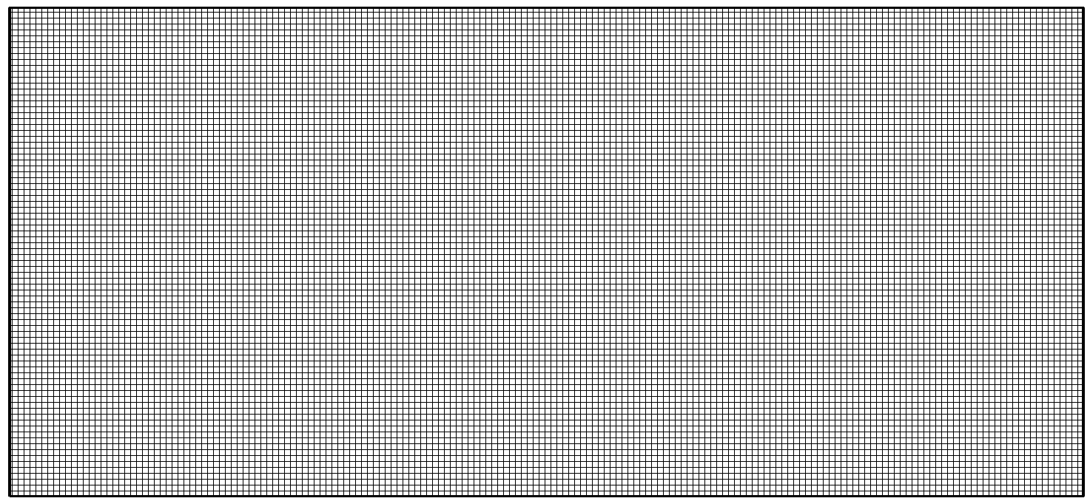
Basic Definitions
Raster: A rectangular array of points or dots.
Pixel (Pel): One dot or picture element of the raster
Scan line: A row of pixels
Video raster devices display an image by sequentially drawing out the pixels of the scan lines that form the raster.

Slide 19
Example
Television
NTSC 640x480x8b 1/4 MB
GA-HDTV 1920x1080x8b ~2 MB
Workstations
Bitmapped display 960x1152x1b ~1 Mb
Color workstation 1280x1024x24b 5 MB
Laserprinters
300 dpi (8.5”x300)(11”x300) 1.05 MB
2400 dpi (8.5”x2400)(11”x2400) ~64 MB
Film (line pairs/mm)
35mm (diagonal) slide (ASA25~125 lp/mm) = 3000
3000 x 2000 x 3 x 12b ~27 MB

Slide 20
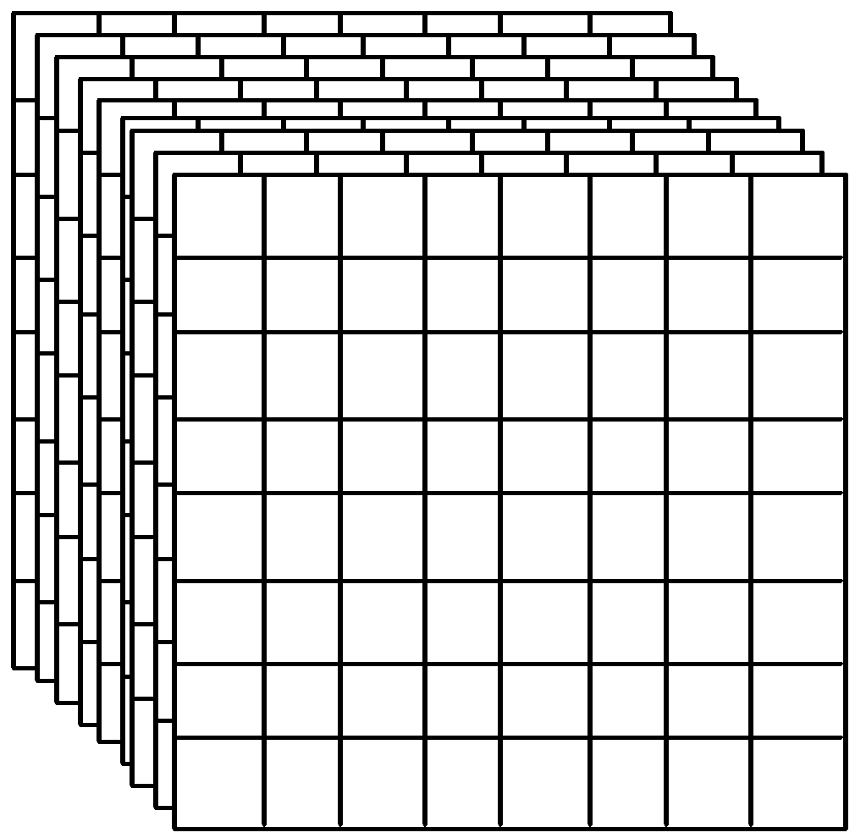
Frame Buffer
A frame buffer is characterized by its size, x, y, and pixel depth.
the resolution of a frame buffer is the number of pixels in the display. e.g. 1024x1024 pixels.
Bit Planes or Bit Depth is the number of bits corresponding to each pixel. This determines the color resolution of the buffer.
Dual ported (simultaneously writing values and displaying in the monitor)
Bilevel or monochrome displays have 1 bit/pixel (128Kbytes of RAM)
8bits/pixel -> 256 simultaneous colors 24bits/pixel -> 16 million simultaneous colors

Slide 21
Comparing Raster and Vector (1/2)
advantages of vector:
very fine detail of line drawings (sometimes curves), whereas raster suffers from jagged edge problem due to pixels (aliasing, quantization errors)
geometry objects (lines) whereas raster only handles pixels
eg. 1000 line plot: vector disply computes 2000 endpoints
raster display computes all pixels on each line

Slide 22
Comparing Raster and Vector (2/2)
advantages of raster:
cheaper
colours, textures, realism
unlimited complexity of picture: whatever you put in refresh buffer, whereas vector complexity limited by refresh rate
HYBRIDS?

Slide 23
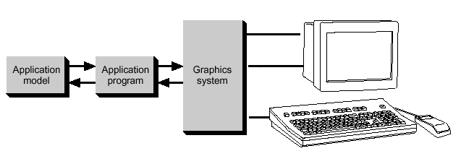
Conceptual Framework for Interactive Graphics
Graphics library/package is intermediary between application and display hardware (Graphics System)
Application program maps application objects to views (images) of those objects by calling on graphics library. Application model may contain lots of non-graphical data (e.g., non-geometric object properties)
User interaction results in modification of image and/or model
This hardware and software framework is 5 decades old but is still useful
Software
Hardware
Graphics
System/
GPU
Graphics
Library
Application
program
Application
Model / database

Slide 24





Graphics Library
Examples: OpenGL™, DirectX™, Windows Presentation Foundation™ (WPF), RenderMan™, HTML5 + WebGL™
Primitives (characters, lines, polygons, meshes,…)
Attributes
Color, line style, material properties for 3D
Lights
Transformations

Slide 25
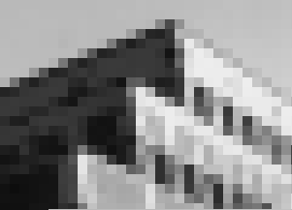
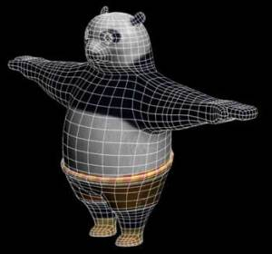
Application Distinctions: Two Basic Paradigms
Sample-based graphics v/s Geometry-based graphics

Slide 26
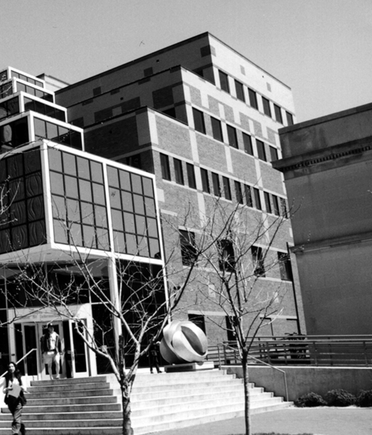

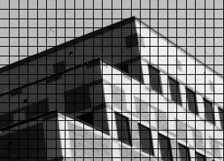
Sampling an Image
Lets do some sampling of a building
A color value is measured at every grid point and used to color corresponding grid square
Crude sampling and image reconstruction method creates blocky image
3D scene
0 = white, 5 = gray, 10 = black

Slide 27
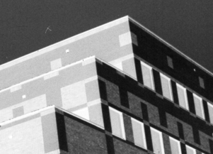
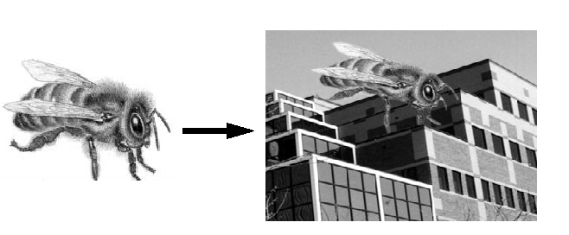
What’s the Advantage?
Once image is defined in terms of colors at (x, y) locations on grid, can change image easily by altering location or color values
E.g., if we reverse our mapping above and make 10 = white and 0 = black, the image would look like this:
Pixel information from one image can be copied and pasted into another, replacing or combining with previously stored pixels

Slide 28
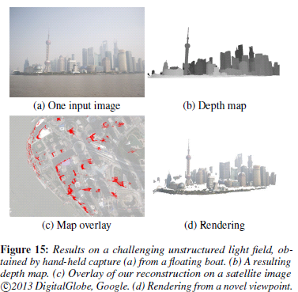
What’s the Disadvantage?
WYSIAYG (What You See Is All You Get): No additional information
no depth information
can’t examine scene from different point of view
at most can play with the individual pixels or groups of pixels to change colors, enhance contrast, find edges, etc.
But increasingly great success in image-based rendering to fake 3D scenes and arbitrary camera positions. New images constructed by interpolation, composition, warping and other operations.
For a computational and cognitive science perspective, Take Thomas Serre’s Computational Vision (CLPS1520)
“Scene Reconstruction from High Spatio-Angular Resolution Light Fields” by Kim, Zimmer et al., 2013

Slide 29
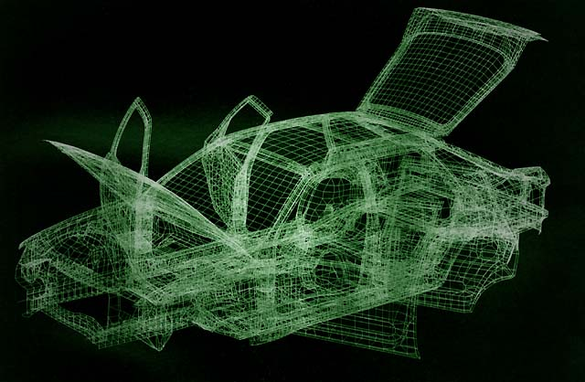
Geometry-Based Graphics
Geometry-based graphics (also called scalable vector graphics or object-oriented graphics): geometrical model is created, along with various appearance attributes, and is then sampled for visualization (rendering, a.k.a image synthesis)
often some aspect of physical world is visually simulated, or “synthesized”
examples of 2D apps: Adobe Illustrator™, Adobe Freehand™, Corel CorelDRAW™
examples of 3D apps: Autodesk’s AutoCAD™, Autodesk’s (formerly Alias|Wavefront’s) Maya™, Autodesk’s 3D Studio Max™

Slide 30
What is Geometric Modeling?
What is a model?
Captures salient features (data, behavior) of object/phenomenon being modeled
data includes geometry, appearance, attributes…
note similarity to OOP ideas
Modeling allows us to cope with complexity
Our focus: modeling and viewing simple everyday objects
Consider this:
Through 3D computer graphics, we have abstract, easily changeable 3D forms, for the first time in human history
Has revolutionized working process of many fields – science, engineering, industrial design, architecture, commerce, entertainment, etc. Profound implications for visual thinking and visual literacy
“Visual truth” is gone in the Photoshop and FX-saturated world (but consider painting and photography…) – seeing no longer is believing…(or shouldn’t be!)

Slide 31
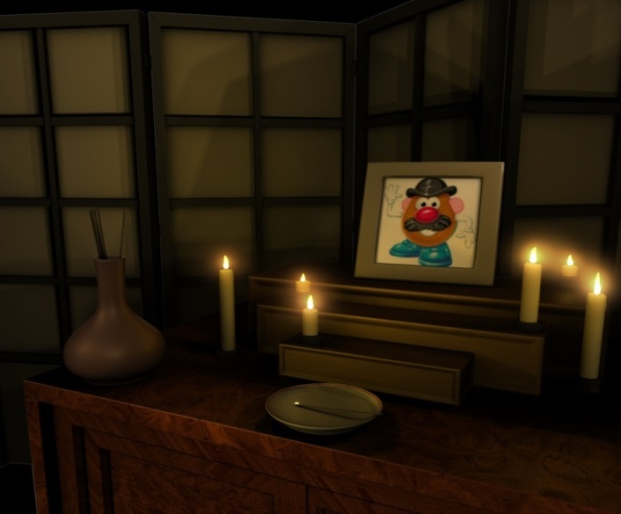
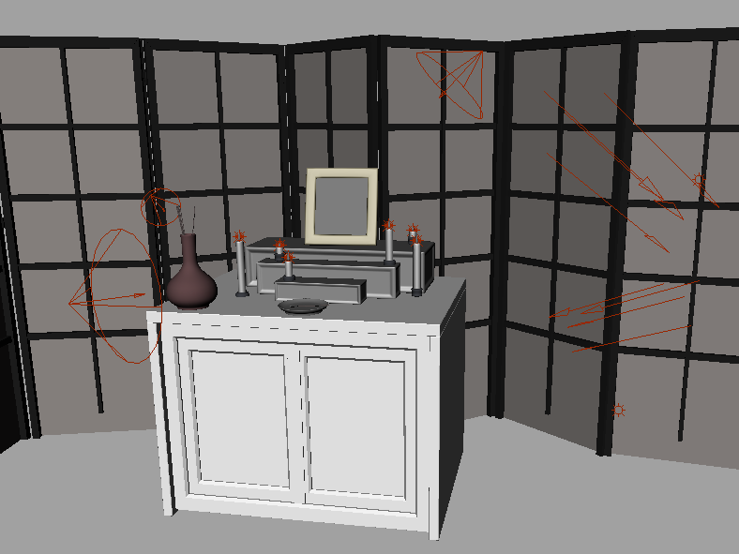
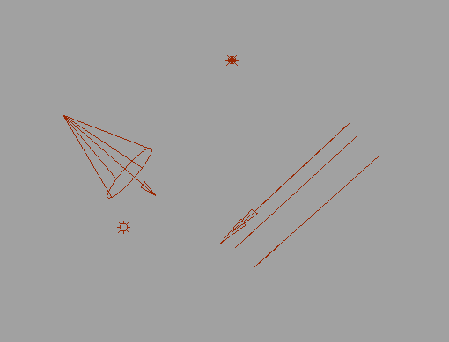
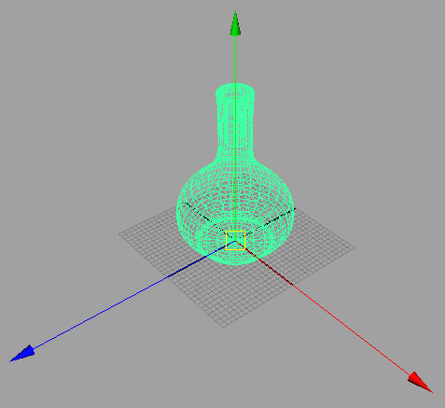
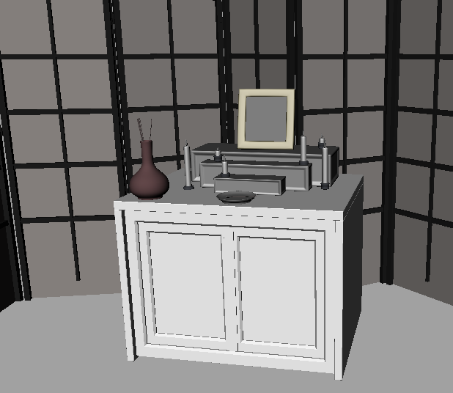
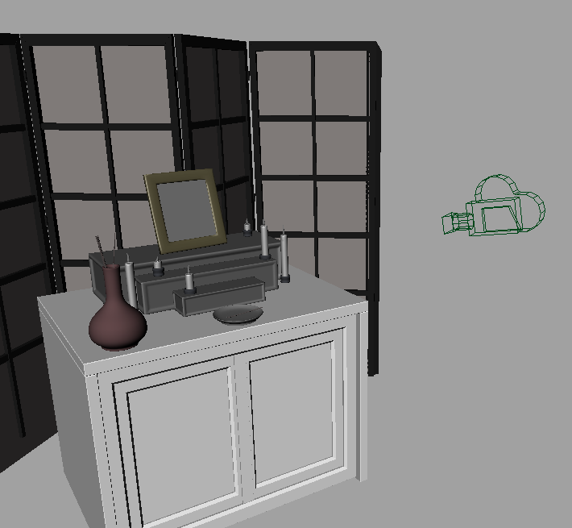
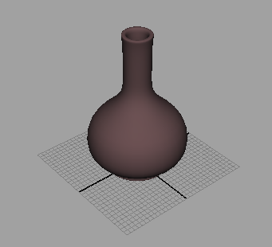
Modeling vs. Rendering
Rendering
Take “picture” with camera
Both can be done with commercial software:
Autodesk MayaTM ,3D Studio MaxTM, BlenderTM, etc.
Modeling
Create models
Apply materials to models
Place models around scene
Place lights in scene
Place the camera
Point Light
Spot Light
Directional Light
Ambient Light

